Slide 1
Notes for the subject teachers
Dear colleagues,
There are different directions in every page at ‘Click to add notes option.’ To conduct the class smoothly it will help you. Before going to start presentation you may read it carefully. Specially trigger animation is introduced in this presentation exclusively.
Your near & dear
Md. Hasan Hafizur Rahman
Mobile : 01556652300
E-mail: hasancambrian@gmail.com
Notes:
If the class teacher follows the instruction here, he will be able to conduct the class smoothly.

Slide 2

Good Morning my dear students.
Notes:
Welcome slide. Teacher may change according to his will.

Slide 3
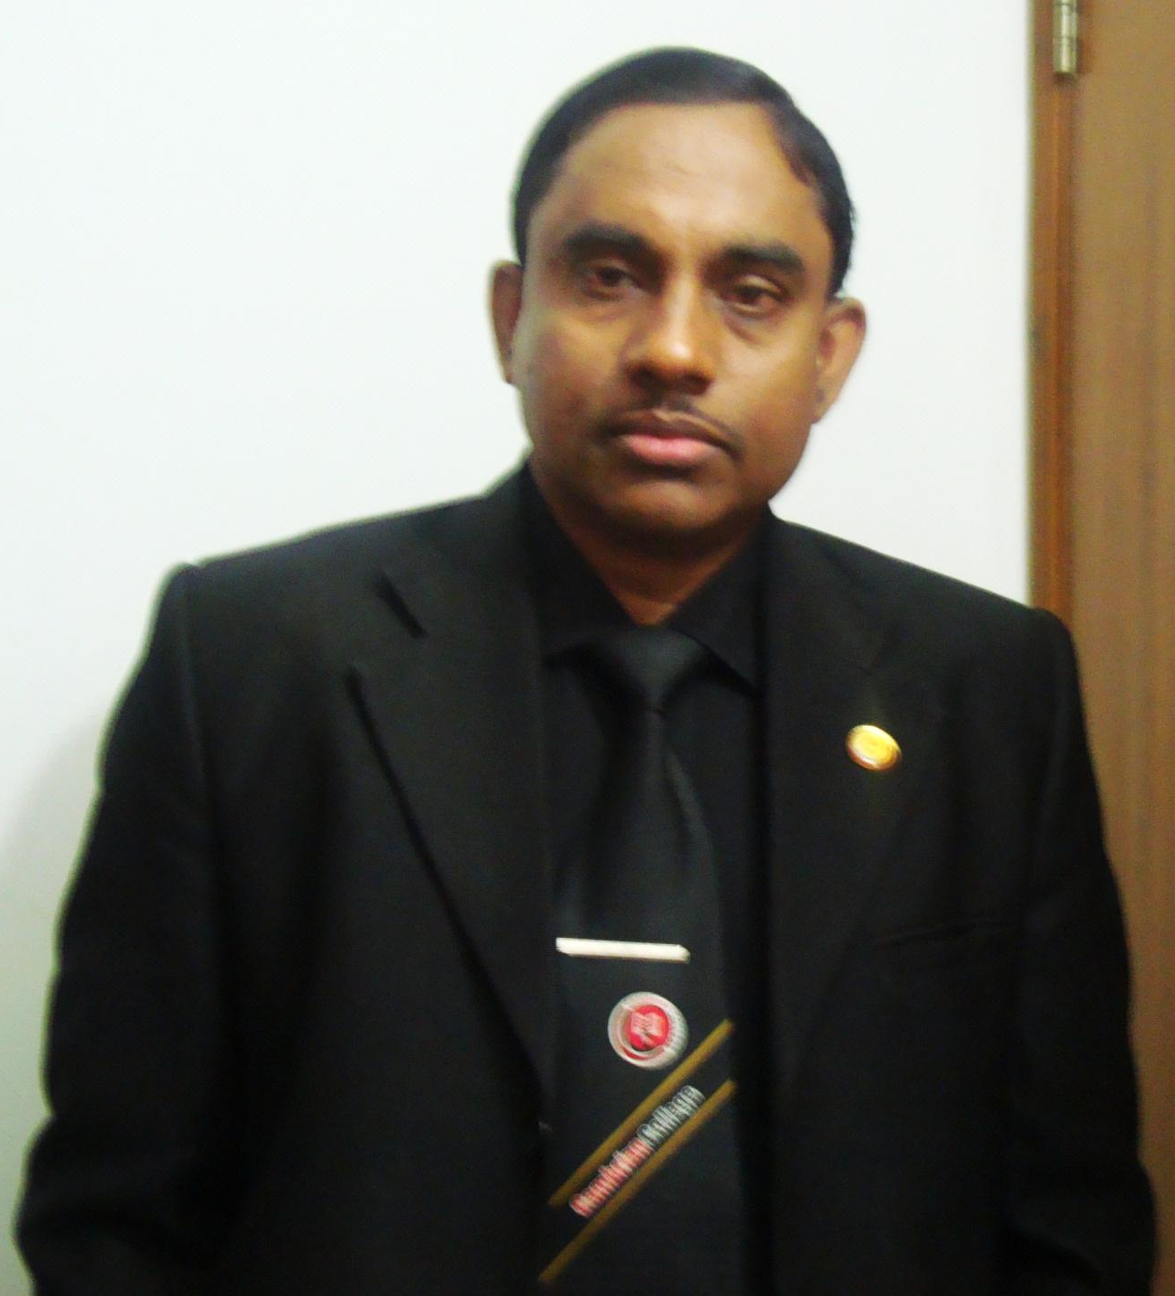
Md Hasan Hafizur Rahman
Lecturer (English)
Cambrian School & College
Building-5, Dhaka
English First Paper
Class Nine & Ten
Notes:
Introduction of the teacher & Class.

Slide 4
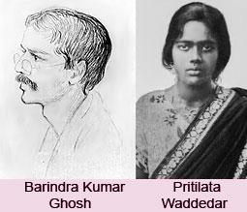
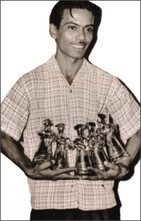
Do you know them?
Pritilata waddedar
Zahir Raihan
Notes:
Suspension to lesson declaration.

Slide 5
They had the dream of Freedom
মুক্তি
What did they dream?
Notes:
The speeches of Anwar Hossain was the dream of Zahir Raihan.

Slide 6

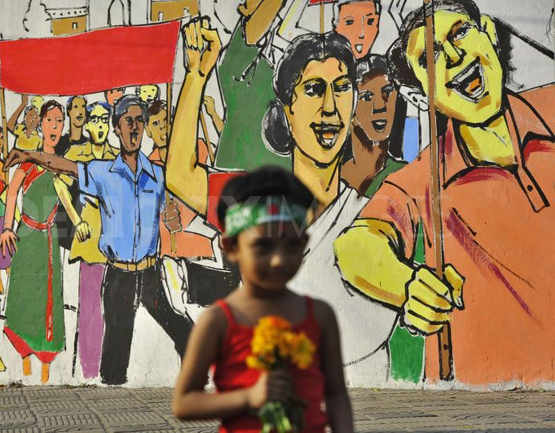
Freedom of speech
Freedom of a country
Notes:
They had the dreams of the above.

Slide 7
Our Today’s lesson is-
They had dreams 2
Unit-10, Lesson-4
Notes:
Lesson declaration.

Slide 8
Learning outcomes
After studied this lesson, learners will able to--
ask and answer questions.
read and understand text through silent reading
take and give interviews.
writing a paragraph.
Notes:
All the four skills will be focused in this lesson.

Slide 9
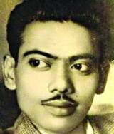
Let’s enjoy a movie song
Who made this movie?
Zahir Raihan
Notes:
Introducement of Zahir Raihan.

Slide 10
Let’s have a look at --
Date of birth
19 August, 1935
Birth place
Village: Majupur
District: Feni
Breathed last
30 December,1971
Notes:
Zahir Raihan’s personnel.

Slide 11
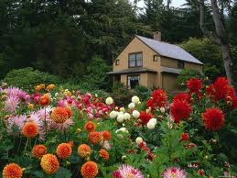




Some important writings of Zahir Raihan
Notes:
Zahir Raihan as awriter.

Slide 12
What was the legendary works of Zahir Raihan?
Jibon Theke Neya
(Bangla Movie)
Notes:
Legendary works of Zahir Raihan.

Slide 13
Important
Dear colleagues,
Slide No 13 -23 are key words/news words option. The sentences are mainly text based. Actually the text information are shown with this option. So this option is fundamental. Please conduct it carefully and sincerely. All the slides of this option are trigger animated. To conduct this option, firstly click on ‘word’ to show the text word, then click in blank space to show the picture, then click ‘Meaning’ to show the meaning of the word and at last click in the blank space below to show the sentence making.
Mr.Hasan

Slide 14
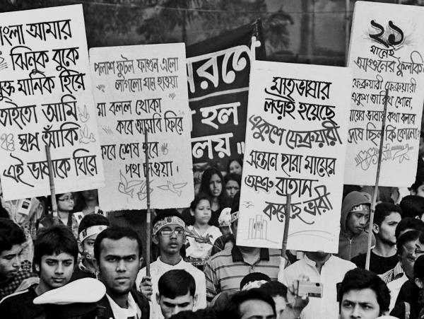
Key word/new words option
Word
Meaning
Procession
Parade, convoy, march past, gathering of people demanding right.
Zahir Raihan attended the procession of 21 February 1952.
Notes:
To conduct this option, firstly click on ‘word’ to show the text word, then click in blank space to show the picture, then click ‘Meaning’ to show the meaning of the word and at last click in the blank space below to show the sentence making.

Slide 15
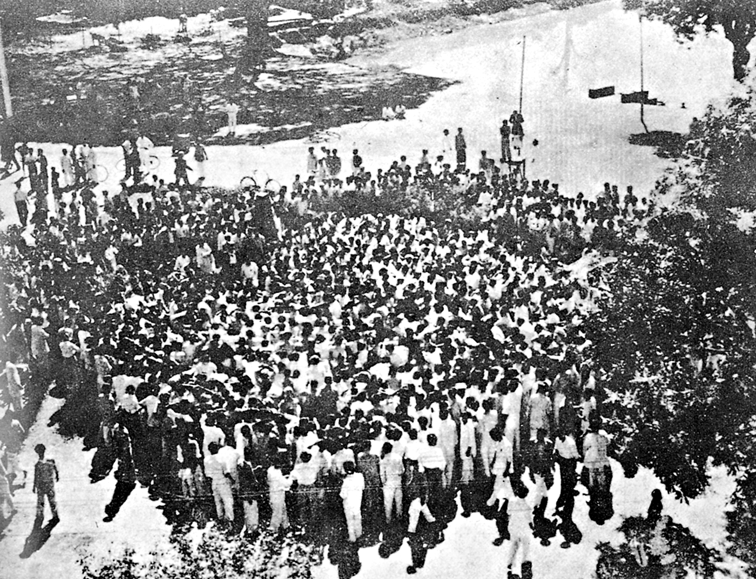
Word
Meaning
Historical meeting
Past ,old, ancient, meeting mentioned in the history
Zahir Raihan was present in the meeting of Amtala on 21 February, 1952.
Notes:
To conduct this option, firstly click on ‘word’ to show the text word, then click in blank space to show the picture, then click ‘Meaning’ to show the meaning of the word and at last click in the blank space below to show the sentence making.

Slide 16
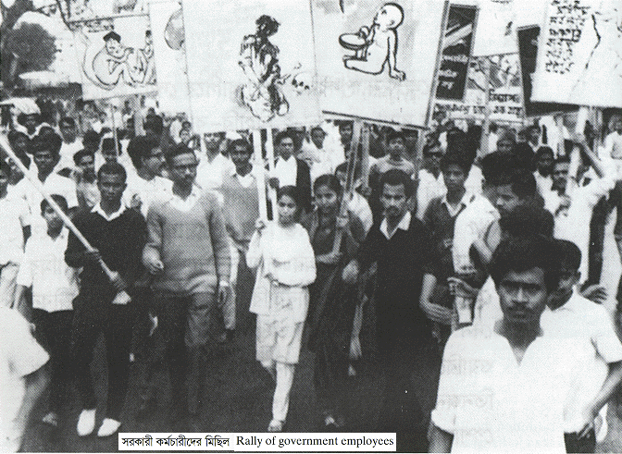
Word
Meaning
Mass movement
Movement participated by all classes of people
He also participated in the mass movement of 1969.
Notes:
To conduct this option, firstly click on ‘word’ to show the text word, then click in blank space to show the picture, then click ‘Meaning’ to show the meaning of the word and at last click in the blank space below to show the sentence making.

Slide 17
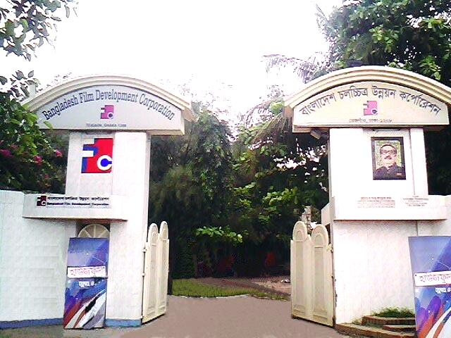
Word
Meaning
Film industry
Movie making industry, FDC
He had many dreams about our film industry.
Notes:
To conduct this option, firstly click on ‘word’ to show the text word, then click in blank space to show the picture, then click ‘Meaning’ to show the meaning of the word and at last click in the blank space below to show the sentence making.

Slide 18
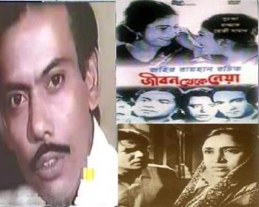
Word
Meaning
legendary
Fabulous, famous, well known
Zahir Raihan made a legendary film ’Jibon Theke Neya.’

Slide 19
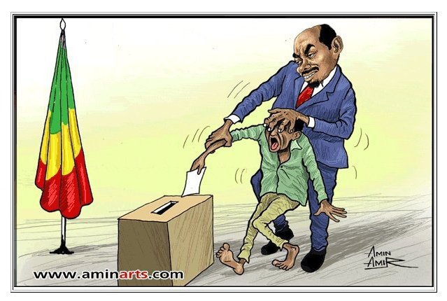
Word
Meaning
Autocratic
Despotic, repressive
Zahir Raihan was always against the autocratic government.
Notes:
To conduct this option, firstly click on ‘word’ to show the text word, then click in blank space to show the picture, then click ‘Meaning’ to show the meaning of the word and at last click in the blank space below to show the sentence making.

Slide 20
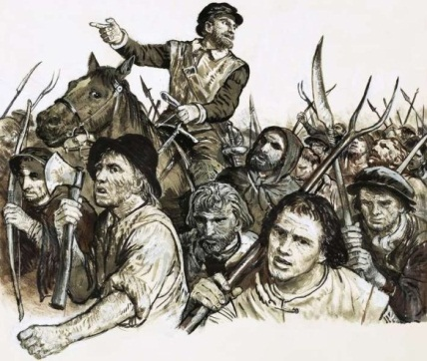
Word
Meaning
Revolt
Riot, mutiny
‘Jibon Theke Neya’ was a revolt against the autocratic government.
Notes:
To conduct this option, firstly click on ‘word’ to show the text word, then click in blank space to show the picture, then click ‘Meaning’ to show the meaning of the word and at last click in the blank space below to show the sentence making.

Slide 21
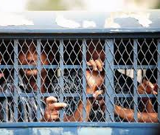
Word
Meaning
Prison
Jail , penal, punishment
The people in the picture are in prison.
Notes:
To conduct this option, firstly click on ‘word’ to show the text word, then click in blank space to show the picture, then click ‘Meaning’ to show the meaning of the word and at last click in the blank space below to show the sentence making.

Slide 22
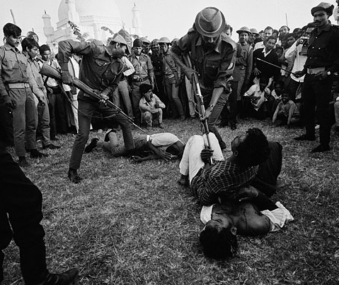
Word
Meaning
Atrocities
Cruelty,
killings, murder, violence
Zahir Raihan showed Pakistani atrocities by his film ‘Jibon Theke Neya’ very well.
Notes:
To conduct this option, firstly click on ‘word’ to show the text word, then click in blank space to show the picture, then click ‘Meaning’ to show the meaning of the word and at last click in the blank space below to show the sentence making.

Slide 23
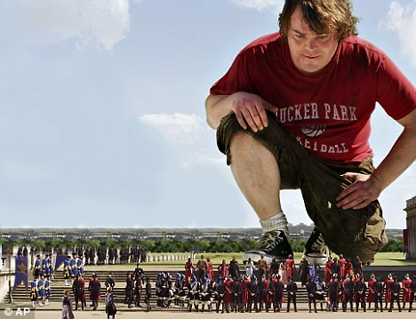
Word
Meaning
Miniature
Small, little, tiny, mini, baby
The people below the stairs look like miniatures.
Notes:
To conduct this option, firstly click on ‘word’ to show the text word, then click in blank space to show the picture, then click ‘Meaning’ to show the meaning of the word and at last click in the blank space below to show the sentence making.

Slide 24
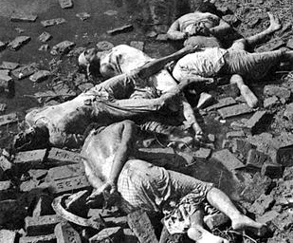
Word
Meaning
Genocide
Mass killing.
He also presented Pakistani genocide by his film ‘Jibon Theke Neya’ very clearly.
Notes:
To conduct this option, firstly click on ‘word’ to show the text word, then click in blank space to show the picture, then click ‘Meaning’ to show the meaning of the word and at last click in the blank space below to show the sentence making.

Slide 25
Let’s have a tour from the text to know the rest of the information by silent reading.
Dear students,
Open your text book at page 126 and start silent reading to answer the following questions. I am always with you to help in case of any inquiry.
Notes:
Teacher may conduct the rest of the class manually just with the help of the text book, board, marker and paper (Khata).

Slide 26
B Read the text.
Zahir Raihan was one of the most talented film makers in Bangladesh. He was bom on 19 August 1935 in the village Majupur, in Feni district. He was an active worker of the Language Movement. He was one of the ten students to go out in a procession on 21 February 1952 despite a ban on such activities. As a result, he and many others were arrested and taken to prison. Zahir was also present at the historical meeting of Amtala on February 21, 1952. He also took part in the mass movement in 1969. In 1971, he joined the Liberation War. All through his life, Zahir dreamt for a democratic society, a society that will ensure freedom of speech and will. He had many dreams about our film industry too. He made a legendary film Jibon Theke Neya based on the Language Movement of 1952. It was a revolt against the then autocratic government. The family presented in that film was a miniature East Pakistan ruled by an autocrat who had to go to the prison for her conspiracy.
Notes:
The given text in this page may be helpful for the teacher anyway. This is why I have given it here though it is supposed not to show text more than 6 lines. So this option may be avoided.

Slide 27
During the liberation war this film was shown outside Bangladesh. Critics like Satyajit Ray, Mrinal Sen, and Ritwik Ghatak appreciated this film. Zahir gave all his money to the Freedom Fighters' trust that he got from his film shows. Besides, his great documentary on Pakistani atrocities, Stop Genocide, helped create world sentiment in favour of our liberation war. On 30 December 1971, someone informed Zahir about an address somewhere at Mirpur, where he might find his brother, the famous writer Shahidullah Kaiser. Shahidulla was captured and killed by the Pakistani army and the local collaborators during the last days of the war. Accordingly Zahir left home to get his brother back and he never returned. Zahir's dream was fulfilled. He could see the inception of a free independent Bangladesh though he did not get back his brother. And it's a pity that this dreamer was missing at such a time when his dream came true.
Notes:
The given text in this page may be helpful for the teacher anyway. This is why I have given it here though it is supposed not to show text more than 6 lines. So this option may be avoided.

Slide 28
C Use appropriate information from the text above to complete the grid.
Zahir Raihan
participated in | famous as | best documentary | movie based on language movement | missing since | his dream
Notes:
Evaluation option.

Slide 29
D Read the following sentences and complete them.
1 Zahir Raihan is famous as …………………………………………….
2 Zahir was imprisoned because ……………………………………….
3 He participated in ………………………………….. and …………….
4 Jibon Theke Neya symbolizes………………………………………….
5 He donated ………………………………………………………………
6 He worked to organize ………………………………………………… by his
great documentary Stop Genocide.
7 His disappearance is a great…………………………………………..
E Work in pairs. Discuss
1 Why is Zahir Raihan considered a freedom fighter though he was a film
maker?
2 How does the title of the lesson fit to the story of Zahir Raihan?
Notes:
Evaluation through completing sentences & pair works.

Slide 30
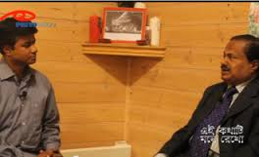
F Project. Work in groups. Meet a freedom fighter in your locality.
Interview him/her. Then write a paragraph on him/her.
Notes:
Group Works. Students themselves may act like the above picture to conduct this session. Teacher will help to do this.

Slide 31
See you again.
Notes:
Last greetings.

